Slide 1

1 PETER

Slide 2
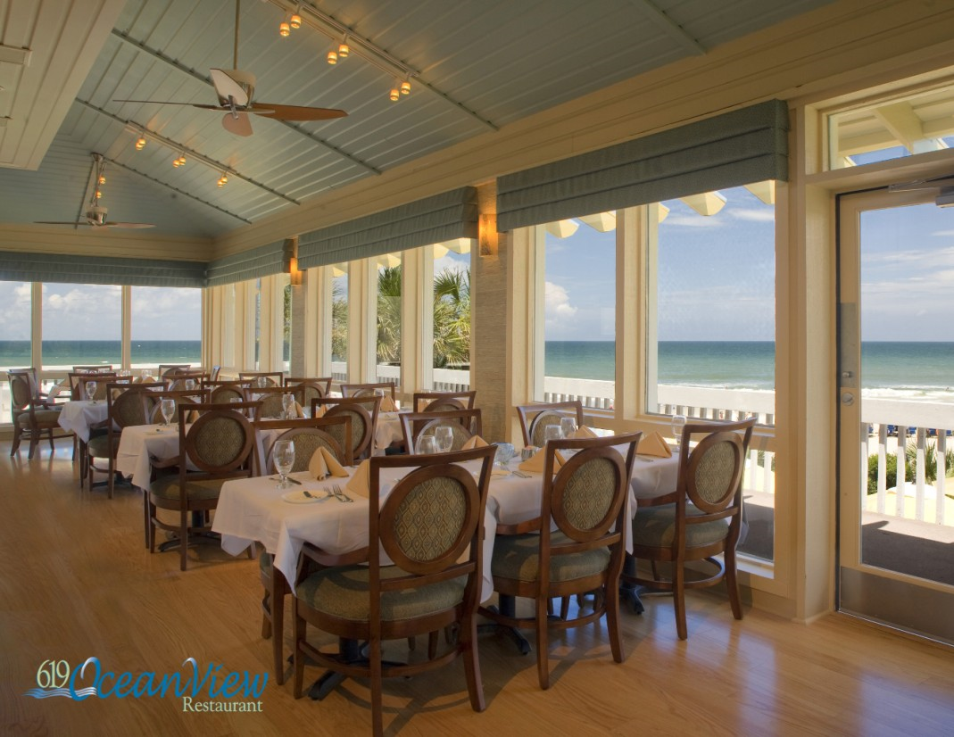
1 PETER

Slide 3
1 PETER
Approximate time of Paul’s appearance before Nero
July 19, AD64 Neronian fire begins
AD61
AD62
AD63
AD64
1 Peter written sometime between AD62-64

Slide 4
1 PETER
Dispersion ~ diaspora
Pilgrims – parepidēmos – 3x; always used of believers

Slide 5
1 PETER
Since you have purified your souls in obeying the truth through the Spirit in sincere love of the brethren, love one another fervently with a pure heart,
Sincere ~ anupokritos
Love~ philadelphia
Love~ agapaō
Fervently ~ ektenōs – to stretch
1 Peter 1.22

Slide 6
1 PETER
Understanding ~ gnōsis

Slide 7
1 PETER
Preached ~ not euangelizō, to bring good news
But kerussō, to make a proclamation

Slide 8
1 PETER
Antitype ~ antitupos – a type is the symbol; antitype is what is symbolized

Slide 9
1 PETER
Baptism DOES saves us –
From a bad conscience

Slide 10
1 PETER
⁸ For he who sows to his flesh will of the flesh reap corruption, but he who sows to the Spirit will of the Spirit reap everlasting life. ⁹ And let us not grow weary while doing good,
for in due season we shall reap
f we do not lose heart. ¹⁰
Therefore, as we have
, let us do good to all,
especially to those who are
of the household of faith.
Galatians 6.8-10

